Slide 1

Process Mining
by
Gurram Mekhala Sumanth
Roll No. 214G1A32A4
Department of Computer Science and Engineering (Data Science)
Srinivasa Ramanujan Institute of Technology
(Affiliated to JNTUA & Approved by AICTE) (Accredited by NAAC with ‘A’ Grade & Accredited by NBA (EEE, ECE & CSE)
Rotarypuram Village, B K Samudram Mandal, Ananthapuramu – 515701.
2023 - 2024

Slide 2

Contents
Course Objective
Introduction
Technology
Applications
Modules
Real-Time Applications
Learning outcomes
GitHub Link
Queries

Slide 3
Course Objective
Learn to interpret process, visualizations and leverage analyses to identify process inefficiencies.
Get an overview of how enterprises the core business processes of enterprises run, and find the hidden value opportunities.
Learn how to discover, validate and improve workflows.

Slide 4
Introduction
What is Celonis?
Celonis is a German data processing company that offers software as a service (SaaS) to improve business processes.
It is headquartered in Munich, Germany and New York, United States.
Common business processes include Purchase-to-Pay (P2P), Order-to-Cash (O2C) or Customer Service processes

Slide 5
contd…
What is Process Mining?
Process mining is a widely-used technology to model, analyze, and optimize business processes.
For example: Think of an MRI that shows how your processes actually run — not how you think they run.
Process mining is a family of techniques relating the fields of data science and process management to support the analysis of operational processes based on event logs.
It is a technique to analyze and track processes

Slide 6
Technology
Process Mining is a product of both data mining and business process management, so it involves various technologies that are part of these two fields.
Database systems are used for storing and managing event logs, which are converted into process models.
Technologies to extract, transform, and load event data from various IT systems within an organization.
RPA(robotic process automation) can be incorporated into process mining since process mining can pinpoint repetitive and rule-based tasks which are enough requirements to implement RPA.

Slide 7
Applications
We can see Process Mining being used for stuff like:
Boosting business intelligence: Data-backed insights and suggested enhancements help stakeholders reach common ground and make business operations decisions faster.
Identifying process bottlenecks: Process mining helps organizations gain a sense of where previously undetected bottlenecks exist so they can address root causes and regain efficiencies in common processes.
Surfacing process deviations: Organizations know how a business process should play out, but with any process comes the potential for deviations that cause workflows to get off-track. Process mining surfaces real processes and actual process steps — including any deviations. These represent opportunities to improve.

Slide 8
Modules
Process Mining
Fundamentals
Technical –
Rising Star

Slide 9
contd…
Process Mining is a set of techniques used for obtaining knowledge and extracting insights from processes by the means of analyzing the event data, generated during the execution of the process.
This training track provides both the theoretical and applied foundations around Process Mining.
Process Mining reads this data, converts it into an event log, and then creates visualizations of the end-to-end process, along with insightful analytics.
An event log contains each step performed during the process (the activity), the time at which the event occurred (the timestamp), and for which instance of the process (the case ID).
Using this event log, algorithms generate a process model that shows the process as it really is - including the timing of each step and all variations.

Slide 10
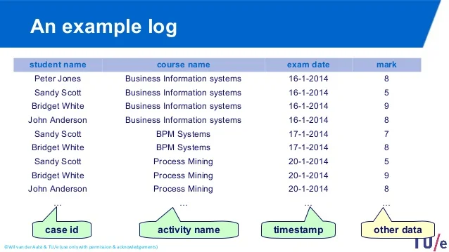
contd…

Slide 11
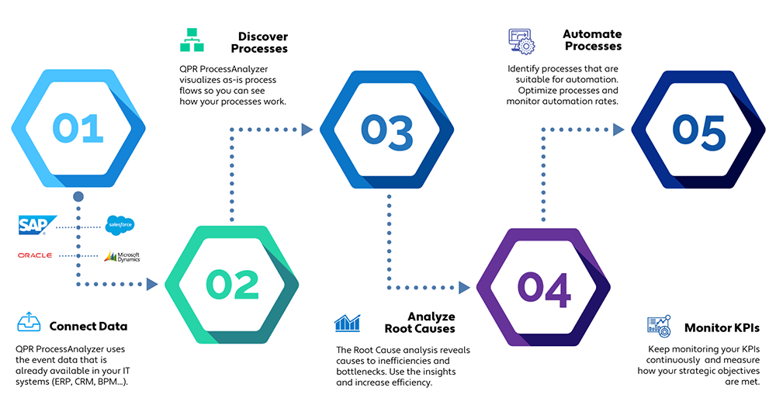
contd…
Steps in Process Mining:
Connect data
Discover processes
Analyze root causes
Automate processes
Monitor KPIs

Slide 12
Celonis Execution Management System (EMS)
What is Celonis EMS?
It’s comprised of execution instruments, execution applications, a developer studio, and an EMS store, all built on top of the Celonis EMS platform. The Celonis EMS helps you increase execution capacity in Customer Operations, Finance & Administration, Supply & Distribution, and Products & Services.

Slide 13
contd…
The Execution Management Consulting program for students is a certification program provided by the Celonis Academic Alliance.
Celonis has 5 different categories of components:
Process Components: Visualize your activities and the way processes flow through them. (Process Explorer and Variant Explorer)
Charts and Tables: Plot you data or group, segment and arrange them in tables. (OLAP Table, Pivot Table, World map)
Single KPI Components: Track your data according to a single KPI. (Key Performance Indicator)
Selection Components: Helps the user create selections.
Design Components: Create design elements for your analysis.

Slide 14
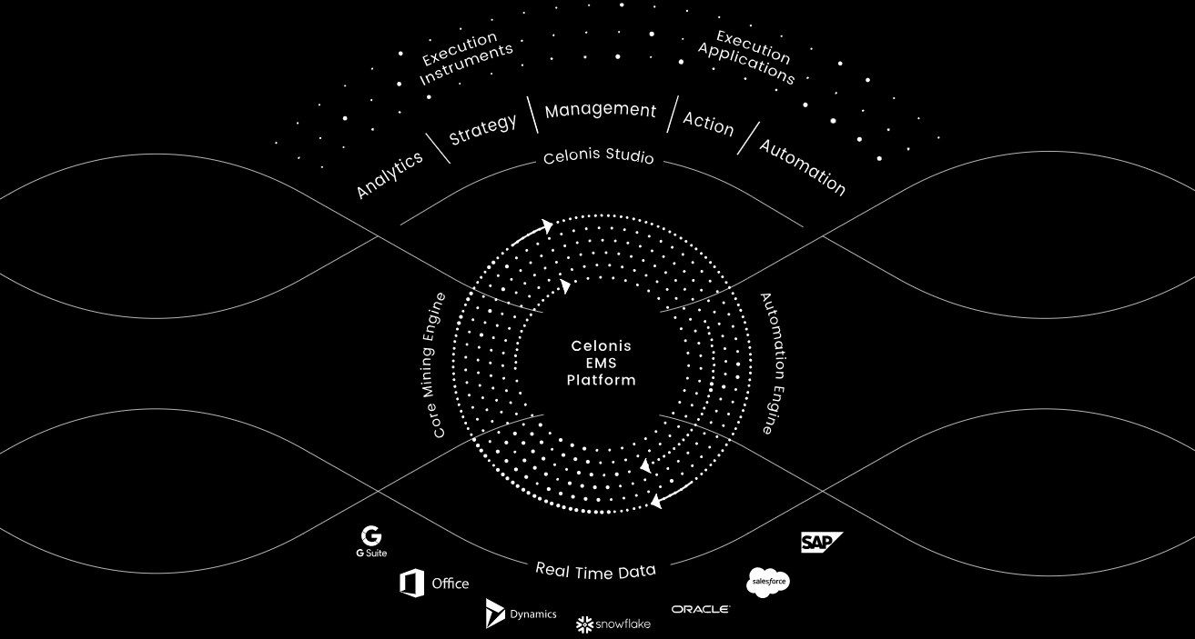
contd…
Celonis EMS Platform

Slide 15
Real-Time Applications
Where is Process Mining used in real life?
General Processes
Sales
IT Service Management
Finance
Automotive
Banking
and many more…

Slide 16
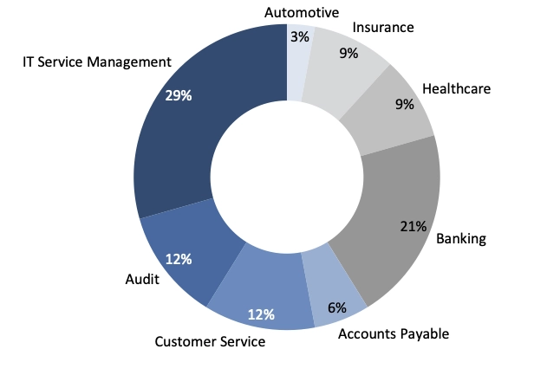
contd…
Applications of Process Mining

Slide 17
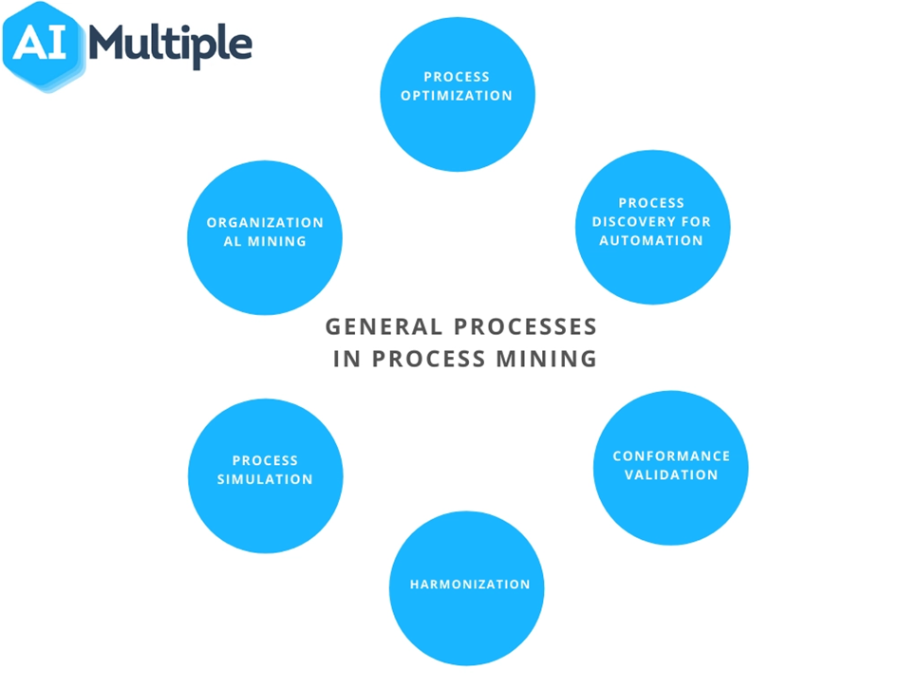
contd…
General Processes

Slide 18
Learning Outcomes
I learnt about the basic fundamentals of Process Mining with the help of Celonis platform.
Got a general idea about what are the steps/stages in Process Mining.
Uses and Real-time applications of Process Mining are learnt successfully.
I also learnt what are the general processes in processes in Process Mining.
The different categories of components in Process Mining.

Slide 19
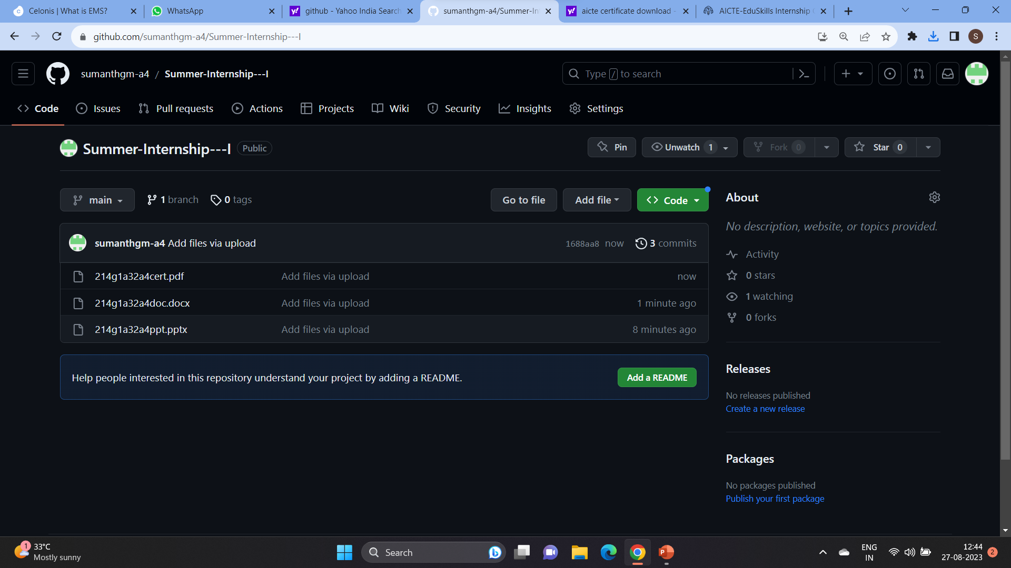
GitHub dashboard and link
GitHub link: Click Here

Slide 20
Any Queries?

Slide 21
Thank You!!!

